Slide 1
Unity “Parenting”
By John

Slide 2
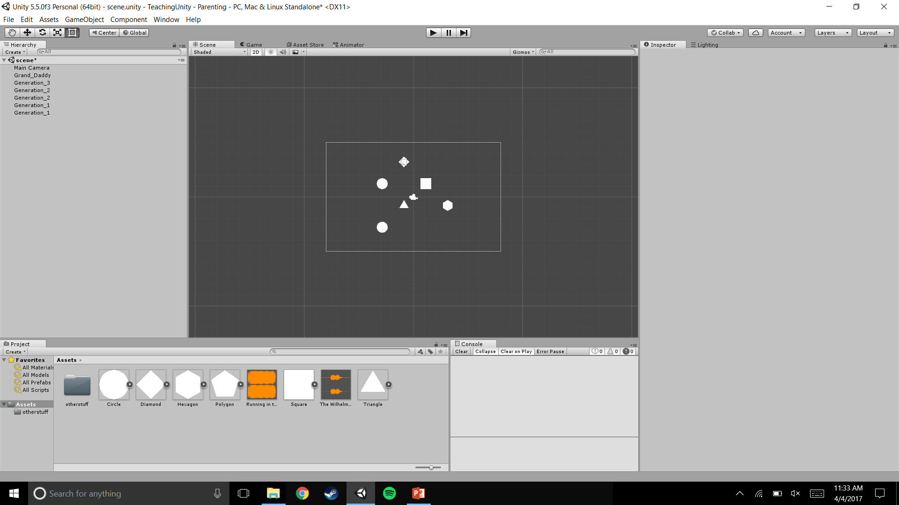
This is what your hierarchy probably looks like

Slide 3
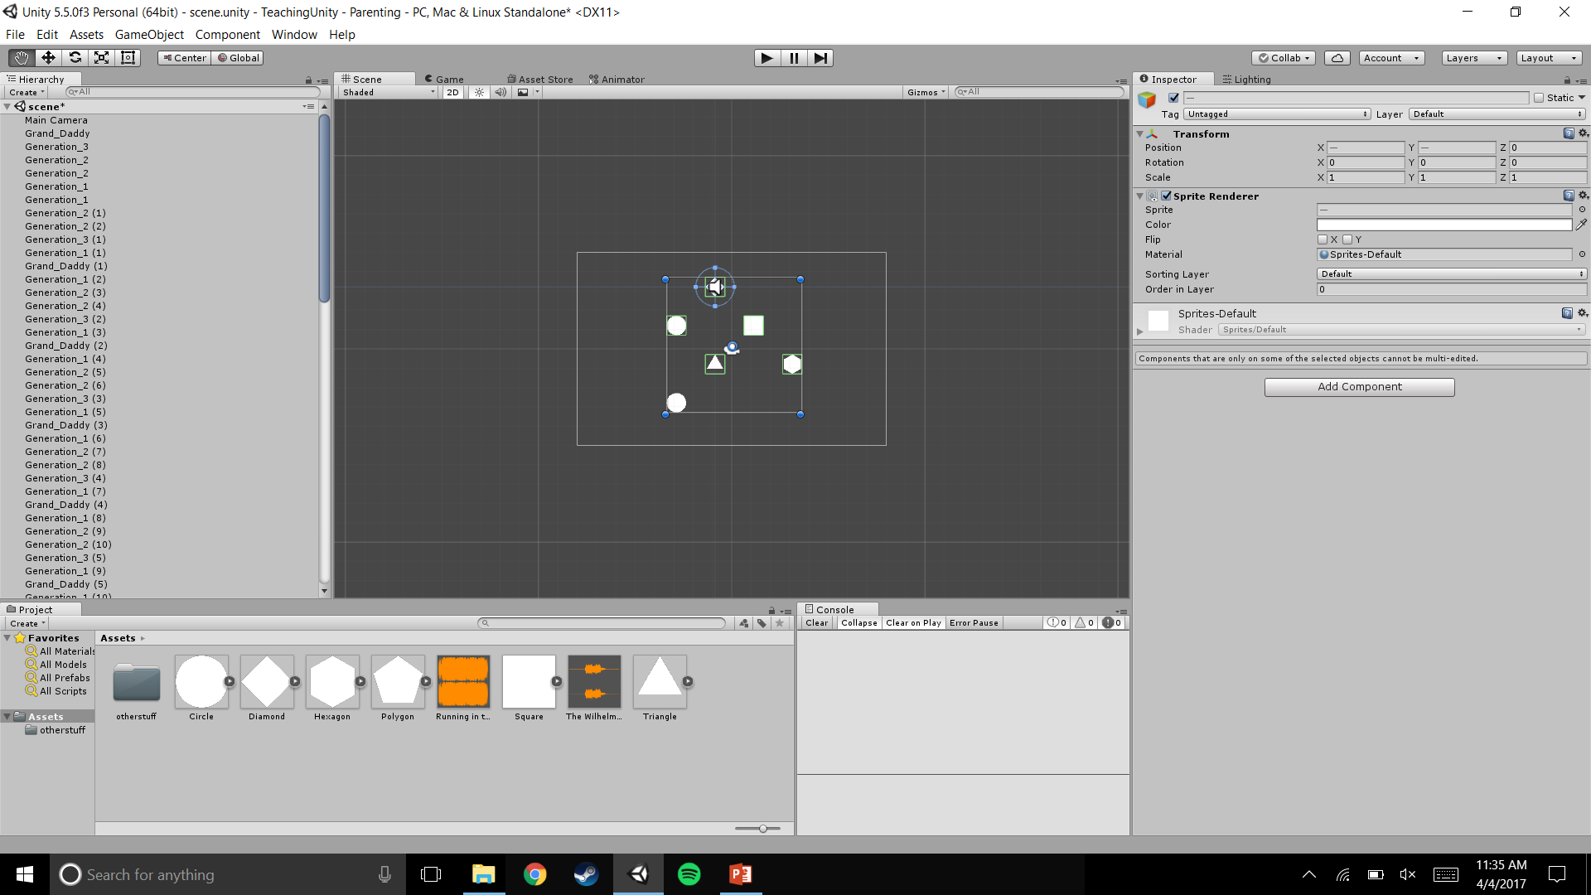
What about complicated, large scenes?

Slide 4

Unit’s solution? Parenting!
Notice the little grey
triangle

Slide 5

Game-Objects have a “parent/child” relationship
Technically, every Game-Object is a child of the “scene” Object, which is what you save when you press ctrl-S.
Again, notice the little
grey triangle.

Slide 6
Every Game objects “transform” component (position, rotation, and scale) is now relative to the parent.
Because of this, every game object has a “world position”, and a “local position”.

Slide 7
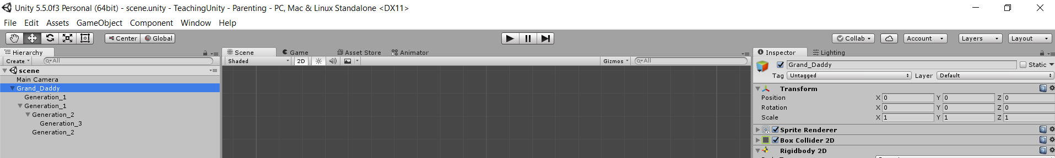
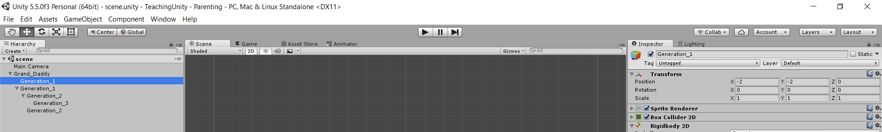
-The parent’s “world position” is (0,0,0).
-The parent has no local position, because it is not a child to anything.
With the parent selected . . .
-The parent’s “world position” is (-2 ,-2 ,0).
-The child’s “local position” is (-2, -2, 0).
With the child selected . . .

Slide 8
What happens if we move the parent object?
If we move the parent object, the child’s transform will follow. However, in the inspector, it will look the same. This is because the inspector shows the local position. If the Game Object does not have a local position, then it shows the World Position.

Slide 9
The parent’s “world position” is (10,0,0).
The parent has no local position, because it is not a child to anything.
With the parent selected . . .
The parent’s “world position” is (8,-2,0).
The child’s “local position” is still (-2, -2, 0).
With the child selected . . .

Slide 10
Think of it like a box.
You can store things in a box.
You can move a box, which will move the things.
You can rotate a box, which will rotate the things.
However, if you move the things, the box will not rotate
If you rotate the things, the box will not rotate.

Slide 11
TLDR;
Parenting is for organizing the Hierarchy.
Changing the parent’s transform changes the child’s transform
Change the child’s transform DOES NOT change the parent’s transform.

Slide 12
Lab7
This is a group lab (each person does the lab)
Decide on a subject
Animal
Human
Automobile
Tree
…
Assign each group member a part of the subject
Joe – head
Mary – legs
Sam – arms…
Share parts in discord (like when you passed your pics to your group
Make an empty GameObject (like the video)

Slide 13
Lab7 - continued
Rename the GameObject whatever the subject is (eg “surfer dude”)
Assemble your GameObject using the parent-child hierarchy
Make at least 3 duplicates of your new GameObject
Rotate at least one of them
Give at least one of them rigid body power
Submit a screen shot like the following slide that shows your hierarchy

Slide 14
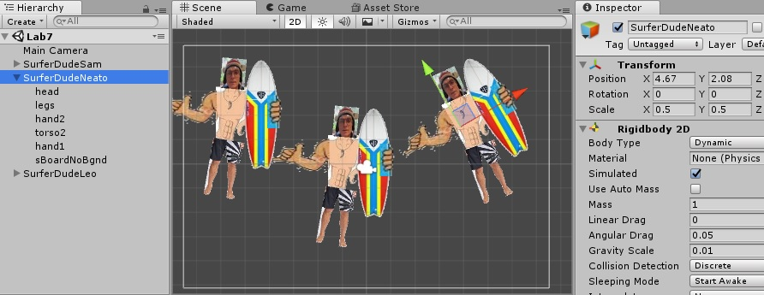
Make sure
this is shown

